Slide 1
CSE 3666 Single-cycle pipeline diagrams with Forwarding
Created by: Prof. Caiwen Ding at UConn

Slide 2
 | CC1 | CC2 | CC3 | CC4 | CC5 | CC6 | CC7 | CC8
I0 | IF | ID | EX | Mem | WB
I1 |  | IF | ID | EX | Mem | WB
I2 |  |  | IF | ID | EX | Mem | WB
I3 |  |  |  | IF | ID | EX | Mem | WB
sub x2, x1, x3
and x4, x2, x5
or x4, x4, x2
add x9, x4, x2

Slide 3
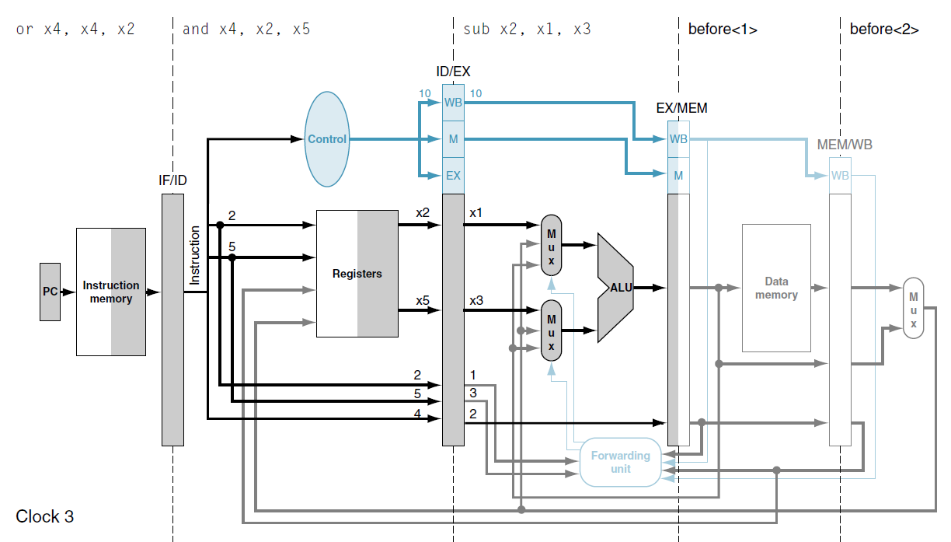
Forwarding Illustrations
Check where used!
sub x2, x1, x3
and x4, x2, x5
or x4, x4, x2
add x9, x4, x2

Slide 4
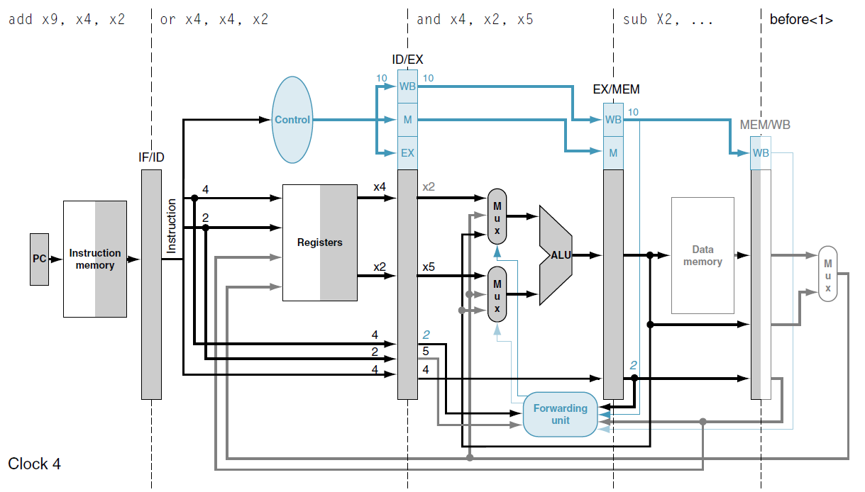
Check where used!
RAW (X2)
sub x2, x1, x3
and x4, x2, x5
or x4, x4, x2
add x9, x4, x2

Slide 5
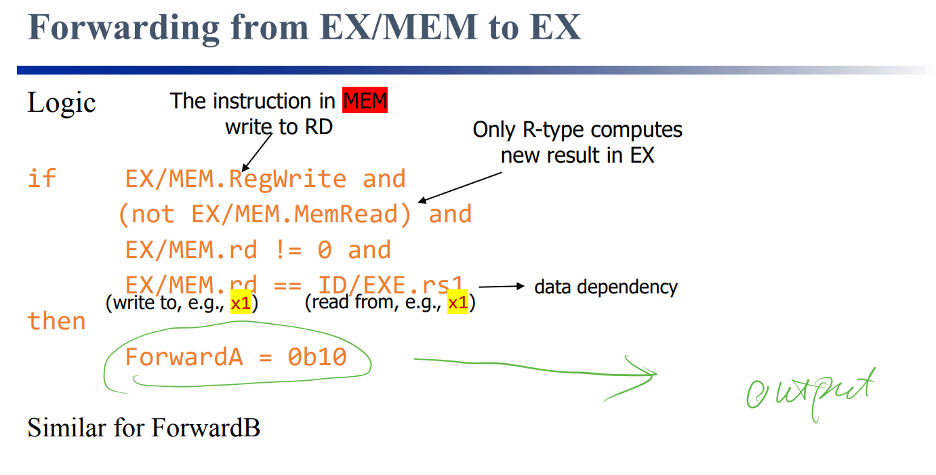
Notes:
WriteRegister.

Slide 6
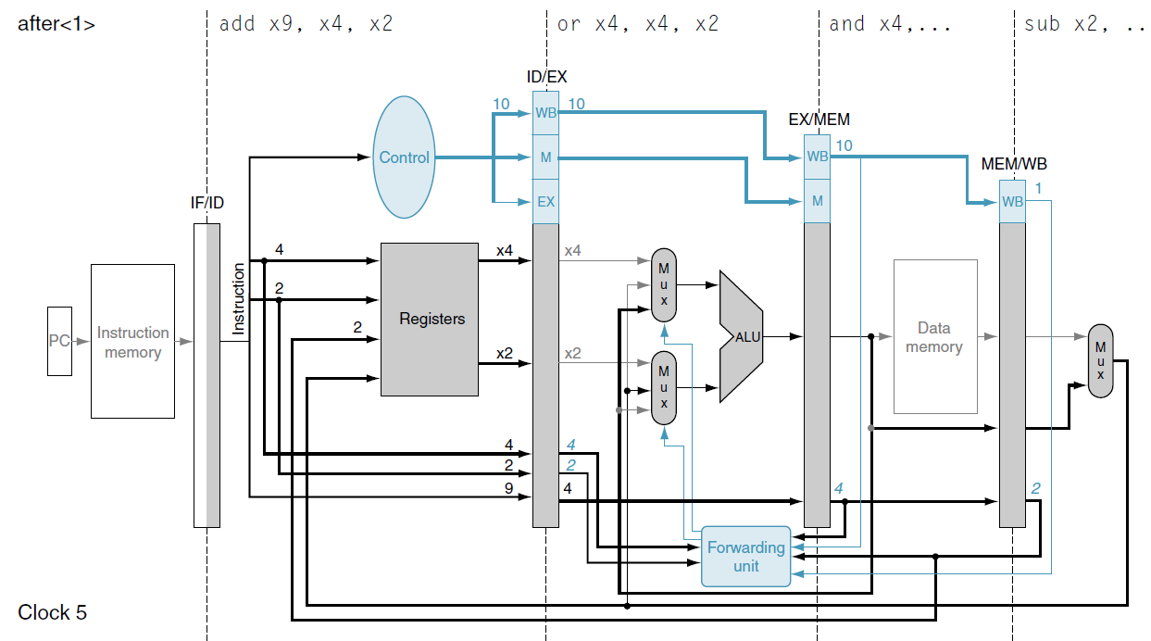
in clock cycle 5, the forwarding unit selects the EX/MEM pipeline register for the upper input to the ALU and the MEM/WB pipeline register for the lower input to the ALU. The following add instruction reads both register x4, the target of the and instruction, and register x2, which the sub instruction has already written. Notice that the prior two instructions both write register x4, so the forwarding unit must pick the immediately preceding one (MEM stage)
Check where used!
RAW (X4)
sub x2, x1, x3
and x4, x2, x5
or x4, x4, x2
add x9, x4, x2
RAW (X2)

Slide 7
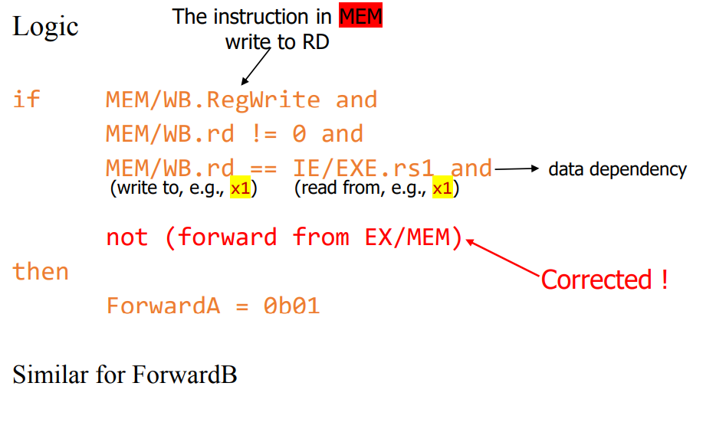
Forwarding from MEM/WB to EX
Notes:
WriteRegister.

Slide 8
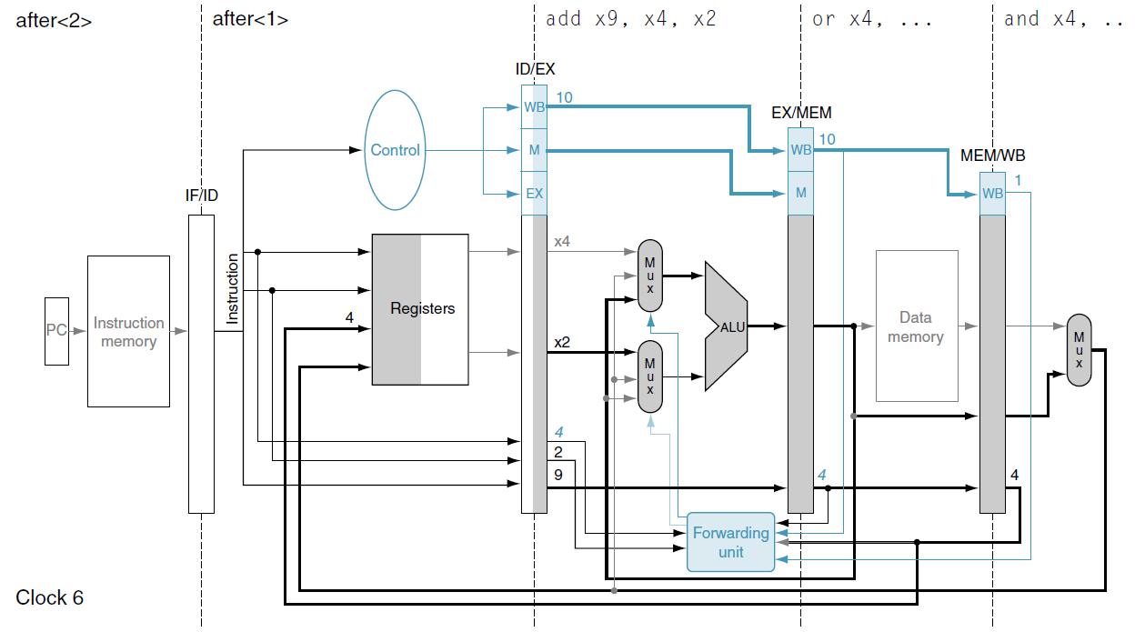
In clock cycle 6, the forwarding unit thus selects the EX/MEM pipeline register, containing the result of the or instruction, for the upper ALU input but uses the non-forwarding register value for the lower input to the ALU.
Check where used!
RAW (X4)
sub x2, x1, x3
and x4, x2, x5
or x4, x4, x2
add x9, x4, x2

Slide 9
 | CC1 | CC2 | CC3 | CC4 | CC5 | CC6 | CC7 | CC8
I0 | IF | ID | EX | Mem | WB
I1 |  | IF | ID | EX | Mem | WB
I2 |  |  | IF | ID | EX | Mem | WB
I3 |  |  |  | IF | ID | EX | Mem | WB
sub x2, x1, x3
and x4, x2, x5
or x4, x4, x2
add x9, x4, x2
?

